Slide 1
ECE 3300L
Lab 6:Multi digit up/down counter with input
Instructor: Dr. Mohamed El-Hadedy
Sami Elias, Joseph Popoviciu

Slide 2
Objective
Modify Lab 5 to use 4 switches to load a value into a specific digit of the seven segment display based on the input switches to a 3x8 decoder.

Slide 3
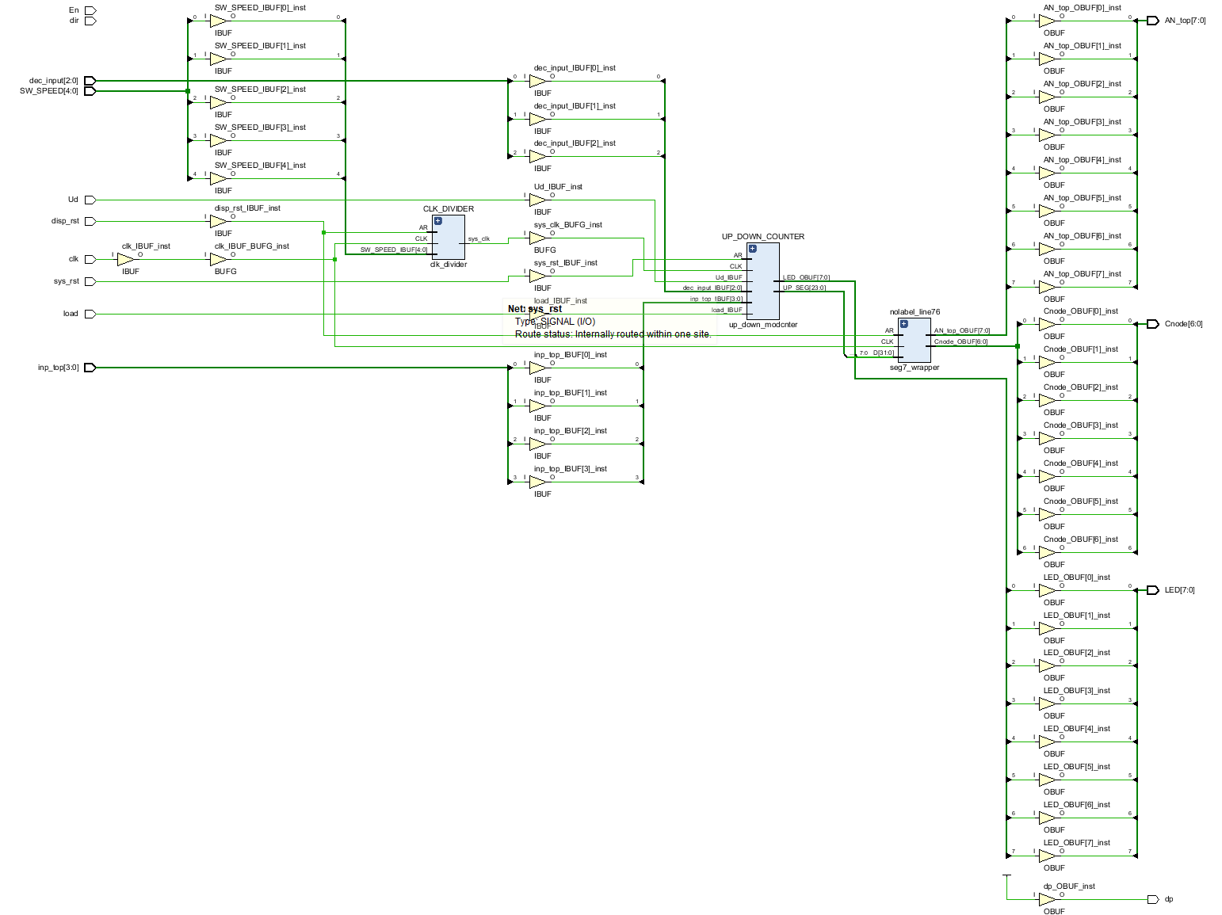
Schematic

Slide 4
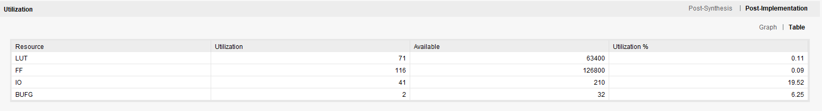
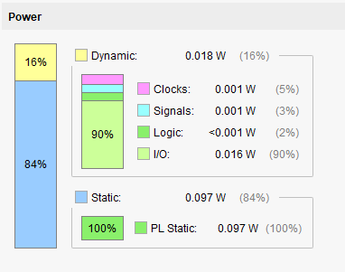
Power and utilization

Slide 5
Results
We used the same clock divider to slow down and speed up the counter.
We included a 3x8 decoder to select which number we want to load into the counter
A button to load value
A button to reset the counter
Switches to select the value we want to load along with the seven-segment display we want it to output in.

